Slide 1

An Insider Data Leakage Detection Using One-Hot Encoding, Synthetic Minority Oversampling and Machine Learning Techniques
Start
Presented by : Shadman
Ankush Jana
Moiz Altaf

Slide 2

“Artificial intelligence and machine learning, as a dominant discipline within AI, is an amazing tool. In and of itself, it’s not good or bad. It’s not a magic solution. It isn’t the core of the problems in the world.”
Vivienne Ming, executive chair and co-founder, Socos Labs
.
Go!

Slide 3

Abstract
Introduction
Methodology
conclusion
Brief idea about the paper
Present day AI
Working of ML model
The Ultimate
Credits

Slide 4

Abstract
As insider threats are the malicious act that can be carried out by an authorized employee with an organization. As insider threats represent a major cybersecurity challenge for private and public organizations. This paper proposes a machine learning-based model to predict the malicious insider with an outstanding prediction accuracy of 0.99 (AUC-ROC) which outperforms several existing valid models on the topic.
Go!

Slide 5
introduction
The ground reality of present day AI
Go!

Slide 6

Back
Nowadays, with the widespread usage of technology to perform many sensitive activities of an organization, security and privacy threats have increased considerably. Among these threats, insider attacks are the most dangerous and costliest types of attacks. Insider attacks are malicious acts performed by users who have authorized access to an organization’s information system. Such characteristics of an authorization have made the threats caused by insiders very difficult to detect. However, overlooking such threats may lead an organization to lose its reputation and business goals. According to IBM X-Force® Threat Intelligence Index , the most common types of attacks are those attacks caused by insiders, which represent almost 60% of total cyberattack.

Slide 7
Insider Threats and Their Consequence
Strategies for Insider Threat DetectioN
Back
Select
Select

Slide 8
Insider Threats and Their Consequence
The Computer Emergency and Response Team (CERT) defined an insider threat as “a current or former employee, contractor, or business partner who has or had an authorized access to an organization’s network, system or data, and intentionally exceeded or misused that access in a manner that negatively affected the confidentiality, integrity, or availability of the organization’s information or information system”
Back

Slide 9
Strategies for Insider Threat Detection
• It proposes a unified model to detect a data leakage threat that could be carried out by a malicious insider during a sensitive period, before his/her leaving to an organization. • It addresses the bias issue that could happen due to an inappropriate encoding process, while detecting the insider threat, utilizing the one-hot encoding method. • It handles the class imbalance problem of the dataset by applying the SMOTE technique. • It implements the most well-known ML algorithms (LR, DT, RF, NB, k-NN and KSVM) for detecting data leakage acts. The performance of the applied algorithms is compared, for a better view of the optimal detection model. • It applies significant metrics for evaluating the performance of ML algorithms (precision, recall, F-measure and AUC-ROC value), as they consider the bias problem of the encoding process and the imbalanced classes of the CERT dataset.
Back

Slide 10

Methodology
The magic part of the model
Go!

Slide 11

Let’s take a look at :
Back
Do you know about these?
overview
Data tabel
Graph
algorithms

Slide 12
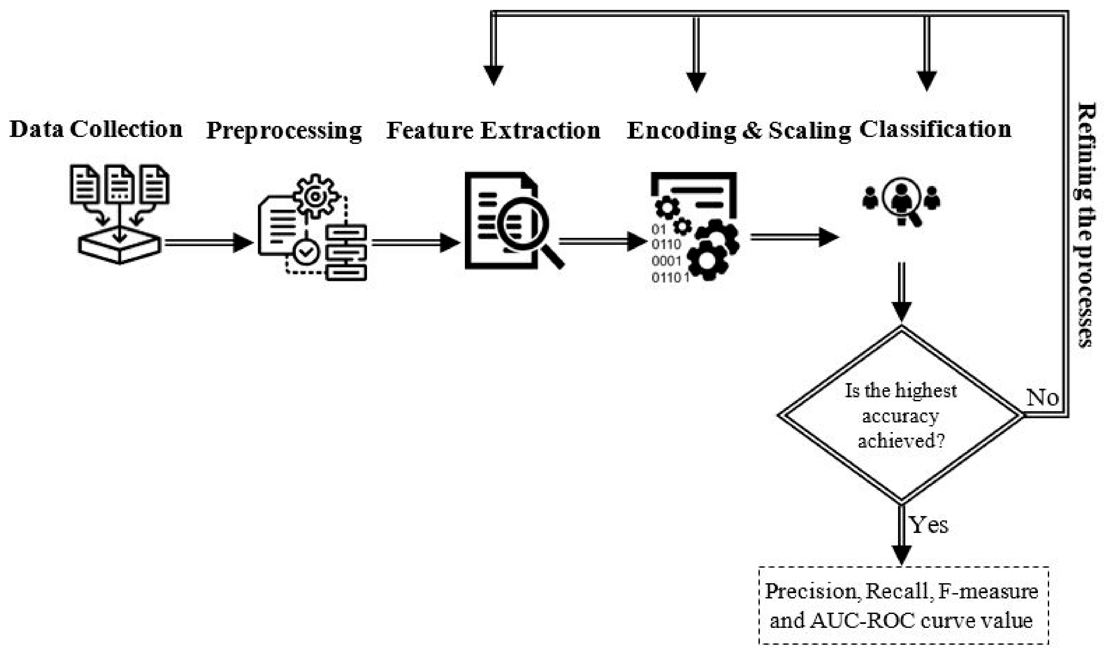
AN overveiw of the system
Back

Slide 13
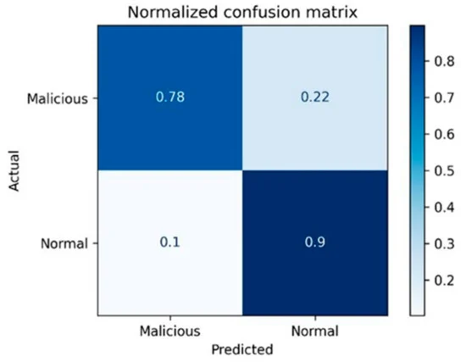
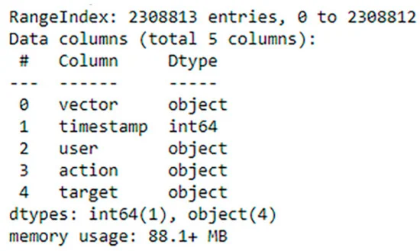
INFOGRAPHICS MAKE YOUR IDEA UNDERSTANDABLE...
Back

Slide 14
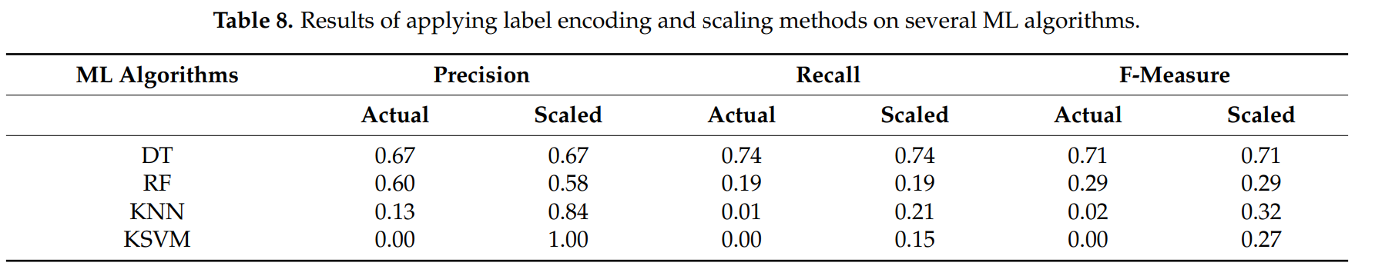
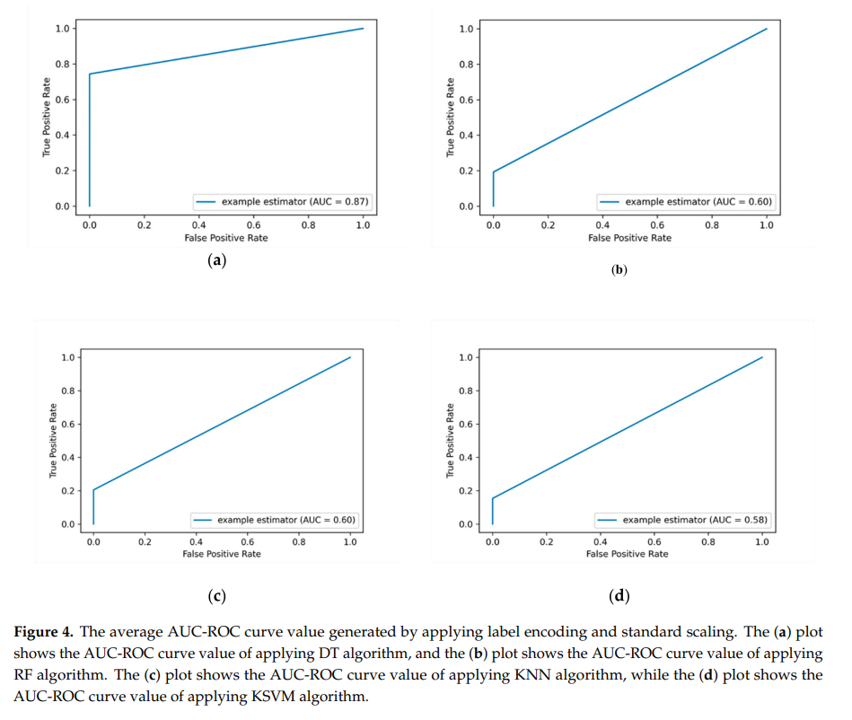

Slide 15
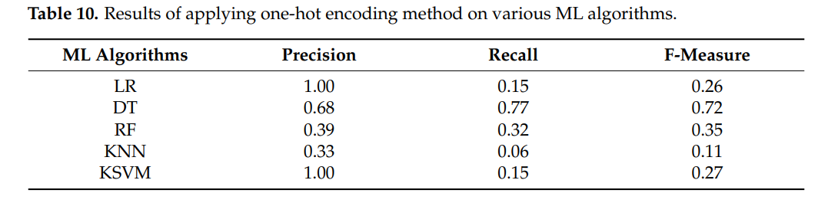
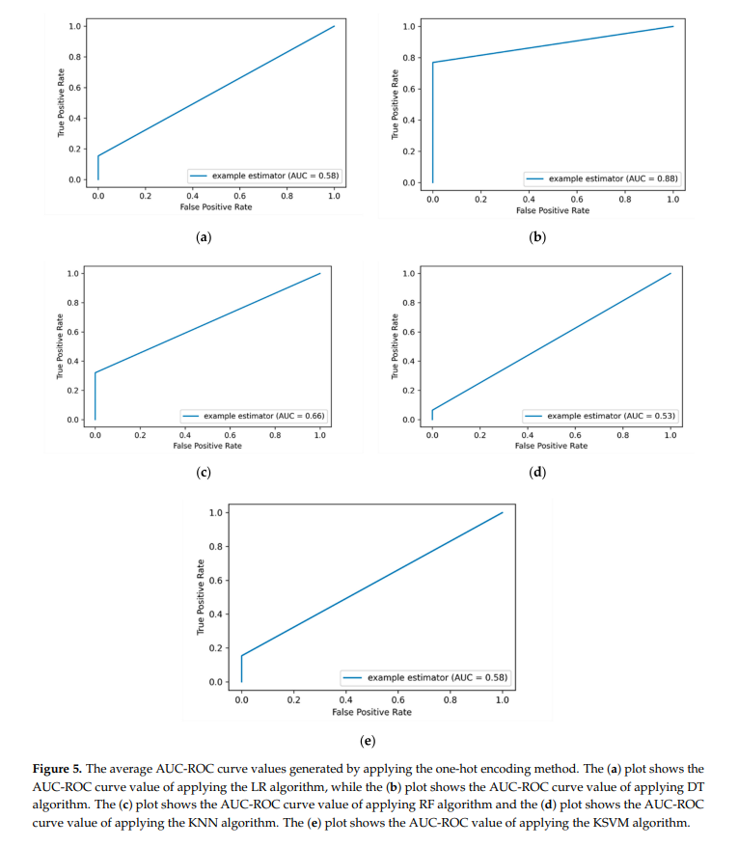

Slide 16
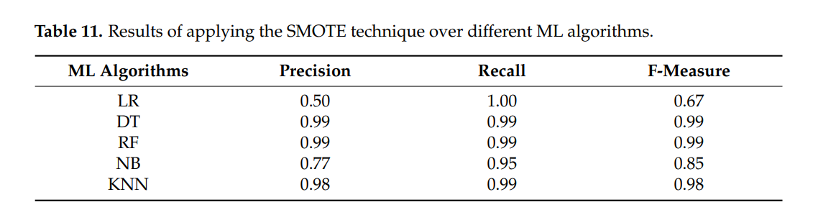
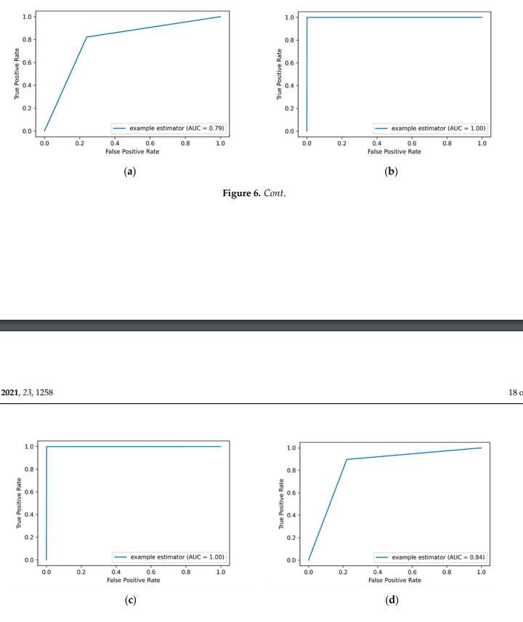

Slide 17
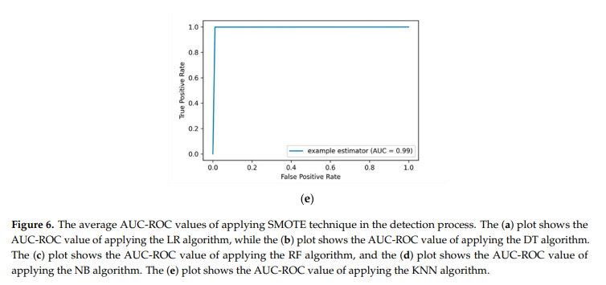

Slide 18
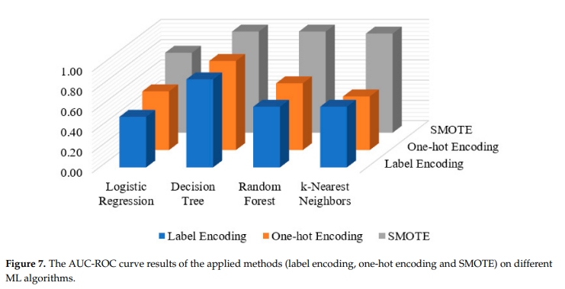
Back

Slide 19
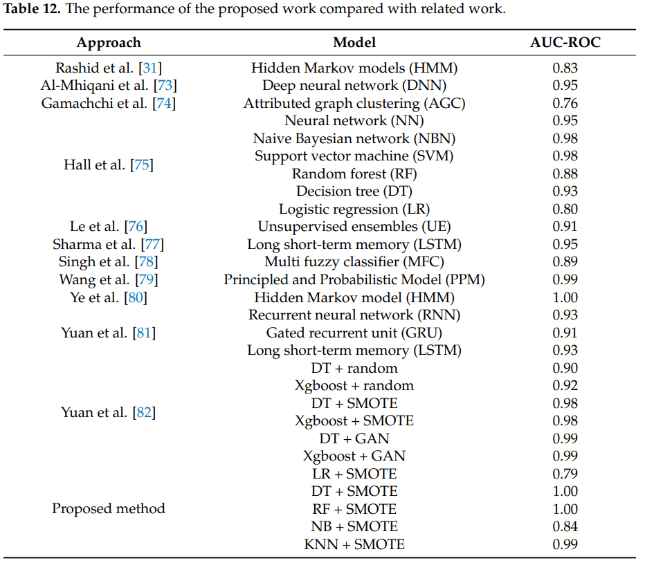

Slide 20
Conclusion: Insider data leakage threat is considered an emerging security threat for organizations , especially when it is carried out by malicious insiders before they leave an organization. In this paper, we present a machine learning based model for detecting insider data leakage events in such a threat scenario. The LR, DT, RF, NB, KNN and KSVM machine learning algorithms are trained on the benchmarking CERT dataset to detect insider data leakage events on unseen data. We employ different methods (label-encoding, feature scaling, one-hot encoding and SMOTE) on data granularity level to address possible bias issues caused by an inappropriate encoding process and the imbalanced class problem of the used dataset . The performance of the proposed model is evaluated via a series of experiments in order to determine the best machine learning model utilizing the appropriate evaluation metrics(recall, precision, F-measure and AUC-ROC value.

Slide 21
References:
Conceptualization, Taher .A.-S. and R.A.A.; methodology, Taher .A.-S.; software, Taher .A.-S. and
R.A.A.; validation, Taher .A.-S. and R.A.A.; formal analysis, Taher .A.-S.; investigation, Taher .A.-S. and R.A.A.;
resources, Taher .A.-S. and R.A.A.; data curation, Taher .A.-S. and R.A.A.;
writing—original draft preparation, T.A.-S.; writing—review and editing, R.A.A.;
funding acquisition, R.A.A. All authors have read and agreed to the published version of the manuscript
https://www.mdpi.com/1289196

Slide 22
Appreciate your time 👍

